Slide 1
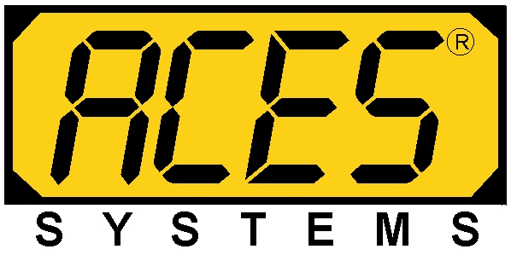
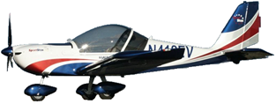
Dynamic
Propeller Balancing Using the Model 1015 ProBalancer Sport
Product Support ACES Systems/TEC Aviation Division

Slide 2
Goals for This Training
Understand Basics of Vibration
Understand the Benefits of Balancing
Understand the Fundamentals for using the ProBalancer Sport for Dynamic Propeller Balancing

Slide 3
Overview
The Basics of Vibration
Definition
Why it happens
How the ProBalancer Sport measures it
How we correct it

Slide 4
The Basics of Vibration Definition
Vibration is defined as:
“mechanical oscillation about an equilibrium point.”
For the purpose of Propeller Balance, vibration can be described as:
“the unwanted, unproductive, cyclic oscillation of the propeller and engine assembly about its rotational axis.”

Slide 5
The Basics of Vibration Remember
All noise and/or vibration is not generated by an imbalance in the propeller.
To verify the vibration source, a vibration survey should be conducted and manufacturers’ limitations adhered to.

Slide 6
The Basics of Vibration Why Does It Happen?
When the weight of a rotating propeller and engine assembly is not equally distributed, the dominant or heavy point attempts to continue moving in a straight line. The resulting force attempts to pull the assembly outside its rotational axis. The assembly then orbits what would be the normal center of rotation, causing vibration.

Slide 7
The Basics of Vibration Vibration-Related Complaints
Cracked exhaust stacks and sheet metal
Higher than normal occurrence of engine and prop oil leaks and light bulb failures
Physical movement of airframe (buzz in the seat, yoke, rudder pedals)
Malfunctioning or failed avionics
Passenger complaints of noise in the cabin

Slide 8
The Basics of Vibration Examples of the Effects of Vibration
Vibration excites natural frequencies in other components throughout the airframe and engine assemblies.
The expended energy from vibration causes wear of components, reduced performance, and passenger discomfort.

Slide 9
The Basics of Vibration How the ProBalancer Sport Measures Vibration
Sensor Type
Sensor Engineering Unit
Characteristics of the Sensor
Sensor Specifications
Sensor Mounting

Slide 10
The Basics of Vibration How It Is Measured
The vibration sensor generates a small voltage when the mass compresses the piezoelectric element. That voltage is proportional to the force being exerted on the element.

Slide 11
The Basics of Vibration How It Is Measured
Sensor Type
The ProBalancer Sport uses an accelerometer to measures the rate of change of velocity with time.
Engineering Unit
gs (equivalent gravities) - acceleration

Slide 12
The Basics of Vibration How It Is Measured
Sensor Characteristics
Accelerometers
Measure Acceleration
Typically Reported in g’s
More Sensitive to Higher Frequencies
Directly Related to Force Caused by Unbalance
Used in Balancing (after conversion to velocity or displacement)

Slide 13
The Basics of Vibration How We Correct It
Improve manufacturing methods
Remove and replace defective components
Static Balance
Static Balance + Dynamic Balance

Slide 14
Overview
Understanding the Benefits of Balancing
The negative effects of vibration
How balancing effects service life and economy of operation

Slide 15
The Benefits of Balancing
Reduces:
Noise
Vibration
Airframe damage
Avionics damage
Fatigue and stress on passengers
Increases:
Economy of operation
Service life of airframe and components
Comfort

Slide 16
Overview
Fundamentals for using the ProBalancer Sport for Dynamic Propeller Balancing
When to balance
Required equipment
Setting up the equipment
Data collection and processing
The balancing process
Avoiding the pitfalls

Slide 17
Fundamentals of Balancing When to Balance
1.25 IPS
Danger - Remove and Static
1.00 IPS
Very Rough – Static balance recommended
.50 IPS
Rough – Dynamic balance recommended
.25 IPS
Slightly Rough - Balance for ride
.15 IPS
Fair - Maximum after Dynamic
.07 IPS
Good - Not felt by occupants
0 IPS

Slide 18
Fundamentals of Balancing When to Balance
An example of a manufacturer’s balancing recommendation.
McCauley Service Letter 1989-4D
Revised July 20, 2001
Endorses dynamic balance on propellers installed on piston and turbine powered aircraft.
Over 0.8 IPS initial reading - list of corrective actions.

Slide 19
Fundamentals of Balancing When to Balance
An example of a manufacturer’s balancing recommendation
Hartzell Service Letter HC-SL-61-165
Revised December 7, 1995
Warns that all propellers need to be inspected for abnormal grease leakage or vibration.
Perform Troubleshooting and evaluate possible sources of vibration IAW engine/airframe mfr. instructions.

Slide 20
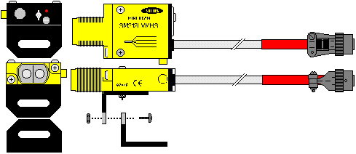
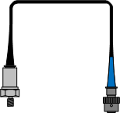
Fundamentals of Balancing Equipment Required
A device to collect vibration and phase data.
A phase angle /speed sensing device
A vibration sensing device
Balance weights and hand tools.

Slide 21
Fundamentals of Balancing Equipment Required
Approved references
Airframe manual
Propeller Manual
Engine manual (in some cases)
FAA-approved “Guide to Propeller Balancing”

Slide 22
Fundamentals of Balancing Equipment Required
Make sure the approval letter is attached to the Guide and references the material being used (document number, date, revision, and change numbers if applicable.)

Slide 23
Fundamentals of Balancing Equipment Required
AC20-37E Chapter 3 Paragraph 300.C.2.(d)
When approved aircraft or propeller manufacturer’s procedures are not available, there are other acceptable dynamic propeller balancing procedures. These include, but are not limited to… ACES Publication No. 100-OM-01, entitled “ACES Systems Guide to Propeller Balancing”. Dynamic balancing of propellers using FAA-approved or -accepted dynamic propeller balancing procedures is not considered a major propeller repair unless the propeller static balance weights are altered or when using… ACES type documents on propeller installations of 500 horsepower or more.
(emphasis added)

Slide 24
Fundamentals of Balancing BEFORE Setting Up the Equipment
Propeller Inspection Prior to Balancing
Ensure all Airworthiness Directives have been accomplished for the propeller you are going to balance.
Determine if there is a balancing procedure published by the airframe, engine or propeller manufacturer; if there is, it will take precedence.

Slide 25
Fundamentals of Balancing BEFORE Setting Up the Equipment
Inspect the propeller blades for damage, nicks etc. refer to FAA Advisory Circular 20-37E which outlines care of metal propellers, and to applicable propeller manufacturers maintenance requirements.
If balancing composite propeller blades, refer to the propeller manufacturer's procedures for repair of the propeller.
Inspect propeller assembly for proper installation and security.

Slide 26
Fundamentals of Balancing BEFORE Setting Up the Equipment
Perform a visual inspection of the spinner and spinner bulkhead for cracks, stop drills and welding. Mass trim weights MUST NOT be attached to a part with any of these conditions.
To prevent an excessive number of weights from being attached to the spinner, remove any mass trim weights attached from previous dynamic balance jobs.
Static balance weight attached to the propeller hub by a certified propeller shop MUST NOT be removed.

Slide 27
Fundamentals of Balancing BEFORE Setting Up the Equipment
Inspect your sensor and its attached cable for obvious damage, such as, chips, pinches, or cuts in the plastic on the cable, and dints or scratches on the sensor, etcetera.
Inspect your tachometer and its attached cable for obvious damage, such as, chips, pinches, or cuts in the plastic on the cable, scratches on the tachometer lens, etcetera.
Ensure the batteries in your analyzer have a sufficient charge to complete the balance job.

Slide 28
Fundamentals of Balancing Setting Up the Equipment
Always attach the vibration sensor as near as possible to the forward most point of the engine and as close to inline with the engine bearing as possible. The base of the sensor should always point to the center of the prop shaft.
The vibration sensor should not be in line with a cylinder and should be positioned at 12:00 whenever possible.

Slide 29
Fundamentals of Balancing Setting Up the Equipment
Attach the Phototach between 12 and 18 inches from the surface of the target blade and not perpendicular (90 degrees) to the surface of the blade. A 5 degree offset is best.
The reflective tape should be a 2 inch long piece of 3M brand 7610, and not less than 1 inch wide. It should be installed no more than 14 inches out the prop blade from the center of the prop shaft.

Slide 30
Fundamentals of Balancing Setting Up the Equipment
Cables should be routed away from rotating and high temp components. Secure with wire ties or tape to prevent excessive movement and possible damage.
Do not close windows or doors on the cables as this may pinch or cut them. Make sure connections at the analyzer are secure.

Slide 31
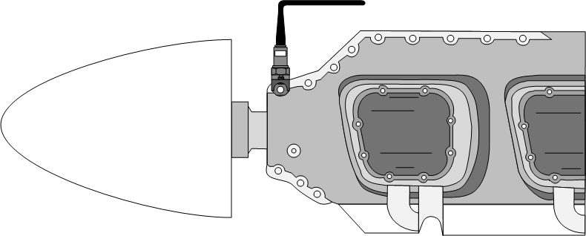
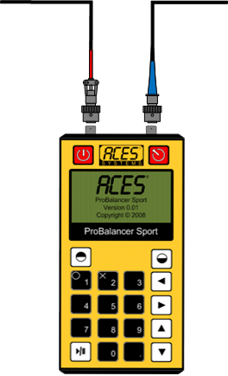
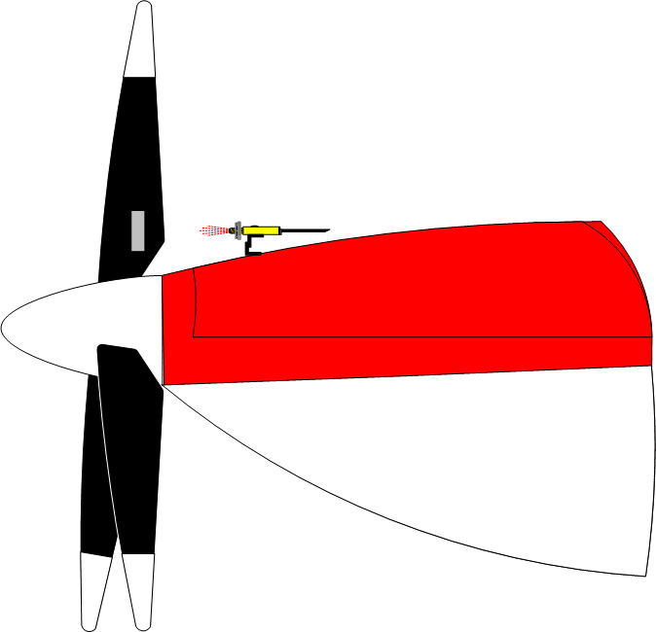
Fundamentals of Balancing Setting Up the Equipment

Slide 32
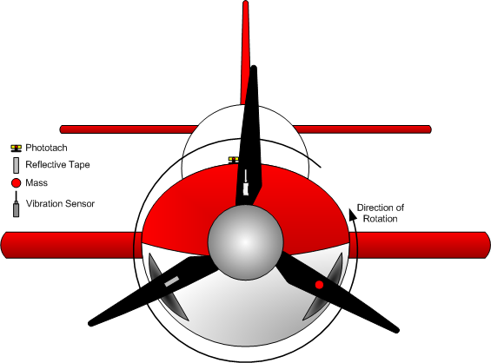
Fundamentals of Balancing Data Collection & Processing
The vibration sensor is installed on the engine as near the front bearing as possible. The Phototach is mounted on the cowling, behind the propeller. The reflective tape is applied to the back side of the target propeller blade in line with the Phototach beam. The mass is the theoretical heavy spot in the propeller, and is located by correlating the “bump” from the vibration sensor and the amount of time that has passed since the Phototach signaled the passing of the reflective tape.

Slide 33
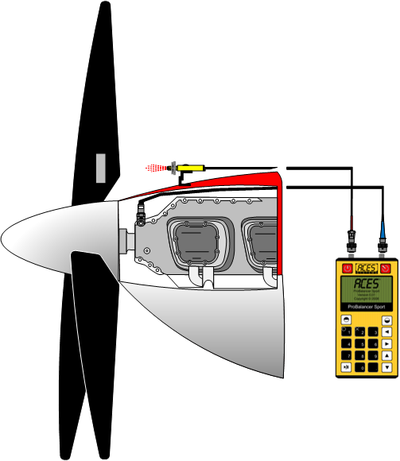
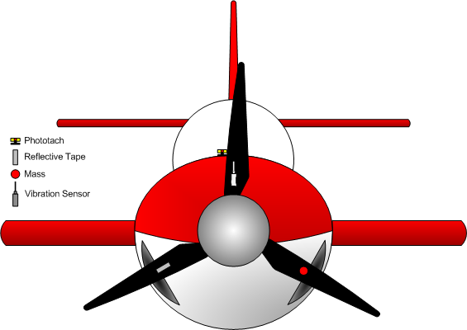
Fundamentals of Balancing Data Collection & Processing
The Reflective tape triggers a response as it passes the Phototach, which then sends an electrical signal to the analyzer.
As the heavy spot on the propeller passes the vibration sensor, the sensor generates an electrical pulse and sends it to the analyzer.

Slide 34
Fundamentals of Balancing Data Collection & Processing
In this illustration, the vibration sensor and Phototach beam are co- located at the 12:00 or 0 degree position. Rotation is clock-wise from the viewers position. This is our starting point, elapsed time = 0

Slide 35
Fundamentals of Balancing Data Collection & Processing
The speed is 1 RPM. Fifteen seconds (90 degrees) of travel has occurred. In this sequence, the reflective tape has just entered the Phototach beam to trigger the tach event. Elapsed time = 15 seconds.

Slide 36
Fundamentals of Balancing Data Collection & Processing
In this sequence, the mass (heavy spot) is passing the accelerometer position, 15 seconds (90 degrees) after the tape passed the Phototach beam. Elapsed time = 30 seconds (180 degrees of travel).

Slide 37
Fundamentals of Balancing Data Collection & Processing
The tape and mass have both passed the 0 degree location. The unit now waits for the exact sequence to repeat for averaging. Elapsed time = 45 seconds (270 degrees of travel)

Slide 38
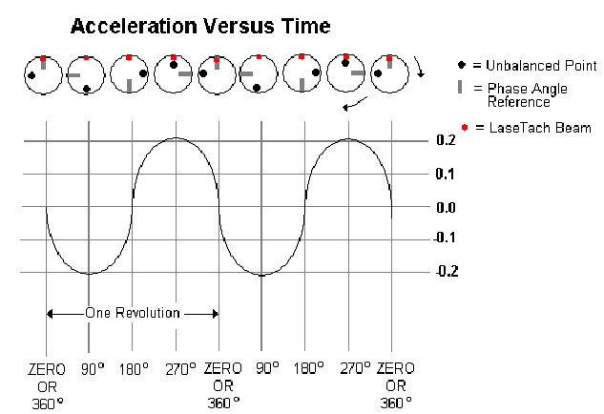
Fundamentals of Balancing Data Collection & Processing

Slide 39
Fundamentals of Balancing Data Collection & Processing
The process is repeated while the analyzer averages out errors caused by momentary vibration events outside the running average.

Slide 40
Fundamentals of Balancing Data Collection & Processing
When sufficient data has been collected, the process is stopped by the analyzer and the averaged data displayed on screen.
Notice that you have the option to Retake the data if desired.

Slide 41
Fundamentals of Balancing Data Collection & Processing
The analyzer will prompt you to shut down the engine.
When less than 50 RPM are recognized by the analyzer, it will progress to the solution screen.

Slide 42
Fundamentals of Balancing Data Collection & Processing
A solution is then provided by the analyzer based on a temporarily stored influence coefficient or a calculated test weight.
If required, the process is then repeated for refinement of the solution.
Notice you have the option to split the weights between two angles if needed.

Slide 43
Fundamentals of Balancing The Balancing Process
With the equipment installed and all previously installed trim weights removed, head the airplane into the wind (10 KTS maximum) and begin the data collection.

Slide 44
Fundamentals of Balancing The Balancing Process
The analyzer will show a screen instructing you to warm the engine and advance your RPM to the designated balancing RPM.

Slide 45
Fundamentals of Balancing The Balancing Process
The analyzer will collect and average data until a sufficient amount of data samples have been collected. This should take between ten and thirty seconds under ideal conditions.

Slide 46
Fundamentals of Balancing The Balancing Process
When the sufficient data has need collected, the Review screen shows the averaged amplitude and the phase angle of the out of balance condition.

Slide 47
Fundamentals of Balancing The Balancing Process
The analyzer will prompt you to shut down. When a RPM reading of less than 50 RPM is indicated the analyzer will progress.

Slide 48
Fundamentals of Balancing The Balancing Process
After the analyzer detects the engines are shut down, it will suggest a balance solution.
If you require a two hole solution select 1 for yes.

Slide 49
Fundamentals of Balancing The Balancing Process
If you split the weights, the analyzer will ask you for the angles of the two available holes.
Enter the angles and press go.

Slide 50
Fundamentals of Balancing The Balancing Process
The analyzer screen will display its suggestion and ask you for the actual angle and weights you installed.
This screen will repeat for each hole location, if you chose to split the weight.

Slide 51
Fundamentals of Balancing The Balancing Process
The start engine screen will be displayed again.
The analyzer will repeat this balance process until the vibration has been driven below .07 IPS.

Slide 52
Fundamentals of Balancing The Balancing Process
Where to place the weights
Test weights can be placed under the spinner retention screws. It may be necessary to use longer screws for the test weights. If doing so, account for the delta between the normal and the longer screw. Be sure you are measuring the angles in relation to the reflective tape.

Slide 53
Fundamentals of Balancing The Balancing Process
Permanent weights may be installed under the flange or on the bulkhead. If installed under the flange, offset from spinner attaching screws by four times the diameter of the spinner screws.

Slide 54
Fundamentals of Balancing The Balancing Process
DO NOT use the spinner attachment screws for permanent weight applications. Apply an equal number of washers to each side of the bulkhead and compensate for the shortened arm when moving weight(s) to the spinner bulkhead.

Slide 55
Correction Calculation
Diameter of spinner divided by 2 = radius of spinner (ex: 14 / 2 = 7.0”)
Minus distance from test weight to permanent weight = permanent weight radius (ex: 7.0 - 1.5 = 5.5”)
Required weight to balance x radius of spinner = net effect (ex: 25 g x 7.0 = 175 Gram inches)
Divide by permanent weight radius = permanent weight (ex: 175 / 5.5 = 31.8 grams)

Slide 56
Fundamentals of Balancing Avoiding the Pitfalls
If you remove the spinner in order to remove previously installed trim weights, index it and make sure it is always reinstalled by the index mark. Check inside the spinner for foreign objects, excess grease and trapped water.

Slide 57
Fundamentals of Balancing Avoiding the Pitfalls
Unstable or erratic RPM readings on the analyzer are most commonly caused by:
Angle of the Phototach relative to the tape.
Phototach outside the 18 inch maximum or inside the 12 inch minimum distance.
Tape too narrow for the velocity of the prop.
Dirty or misaligned tape.
Defective Phototach or Cable.

Slide 58
Fundamentals of Balancing Avoiding the Pitfalls
Unstable or erratic vibration amplitude readings on the analyzer are most commonly caused by:
Damaged or inoperative sensor
Pinched, Cut, or shorted cable
Unstable tachometer input.
Mechanical defects of the assembly being balanced.

Slide 59
Fundamentals of Balancing Avoiding the Pitfalls
You may also adjust the Phototach gain. Remove the screw holding the clear plastic cover on the aft end of the unit.

Slide 60
Fundamentals of Balancing Avoiding the Pitfalls
The gain adjustment is the brass screw at the right. Make adjustment in a controlled environment such as with a bench grinder in a shop.

Slide 61
Fundamentals of Balancing Avoiding the Pitfalls
Adjust the speed of the prop as closely as possible to the exact target RPM on EVERY run. A change in RPM will change the influence of an attached weight. Subsequent solutions will not have the same calculated results at different speeds.

Slide 62
Fundamentals of Balancing Avoiding the Pitfalls
If an established influence for the engine and prop combination being balanced is not being used, the first weight the analyzer will ask you to install is a TEST weight. This weight may cause the vibration amplitude to increase. The intention of the test weight is only to induce a measurable change, not necessarily reduce the vibration.

Slide 63
Fundamentals of Balancing Avoiding the Pitfalls
If the suggested TEST weight is greater than your experience tells you is necessary to induce a change, reduce the weight and enter the exact amount and angle of attachment into the analyzer. Remember that the amplitude may actually go up. This is not a malfunction of the equipment. Continue the balance process.

Slide 64
Fundamentals of Balancing Avoiding the Pitfalls
Test weight calculation.
Test Weight in Grams = ((Engine Horsepower/10)+30)*IPS
g = (1000/10)+30)*1.0
g = (100+30)*1
g = 130

Slide 65
Fundamentals of Balancing Avoiding the Pitfalls
There is no difference in the propeller balance procedure for a radial engine, opposed engine, turboprop, geared, variable pitch, or fixed pitch propeller.

Slide 66
Fundamentals of Balancing Avoiding the Pitfalls
A variety of mechanical problems can show up at propeller turning speed these include
Propeller out of track.
Crankshaft unbalance.
Bearing problems.
Loose or worn components in the engine.
Defective crankshaft counterweights.
Loose or worn components in the propeller hub.
Loose airframe components.

Slide 67
Fundamentals of Balancing Avoiding the Pitfalls
Some indications are:
Applying numerous (more than 3 or 4) solutions without reducing the amplitude.
Phase angle changing radically between runs.
Phase angle that changes dramatically during data acquisition. (At amplitudes below approximately .05 IPS this is not a defect.)

Slide 68
Fundamentals of Balancing Avoiding the Pitfalls
In any of these cases, you will have little to no success with your balancing efforts. If you feel you are chasing the solution, check the equipment on another application before blaming your difficulties on the analyzer.

